Slide 1
Supermarket Analysis
Atharva Kousadikar

Slide 2
Contents
About Data
Goals/ Business Questions
Tableau Analysis
Model
Time Series Forecasting
Conclusion

Slide 3
About Data
Data : Supermarket Data with 21 attributes and 9995 rows.
Data has record of Different categories sales and their profit according to the region with period duration – (2014 to 2017)
DATASET source: https://community.tableau.com/docs/DOC-1236

Slide 4
Goals/ Business Questions
Where is Superstore Unprofitable?
What is common shipping mode preferred?
What segmentation gives more profit to store?
Which state(city) specifically should store invest more?
Forecasting future profit estimates for different categories

Slide 5

ANALYSIS BY TABLEAU

Slide 6
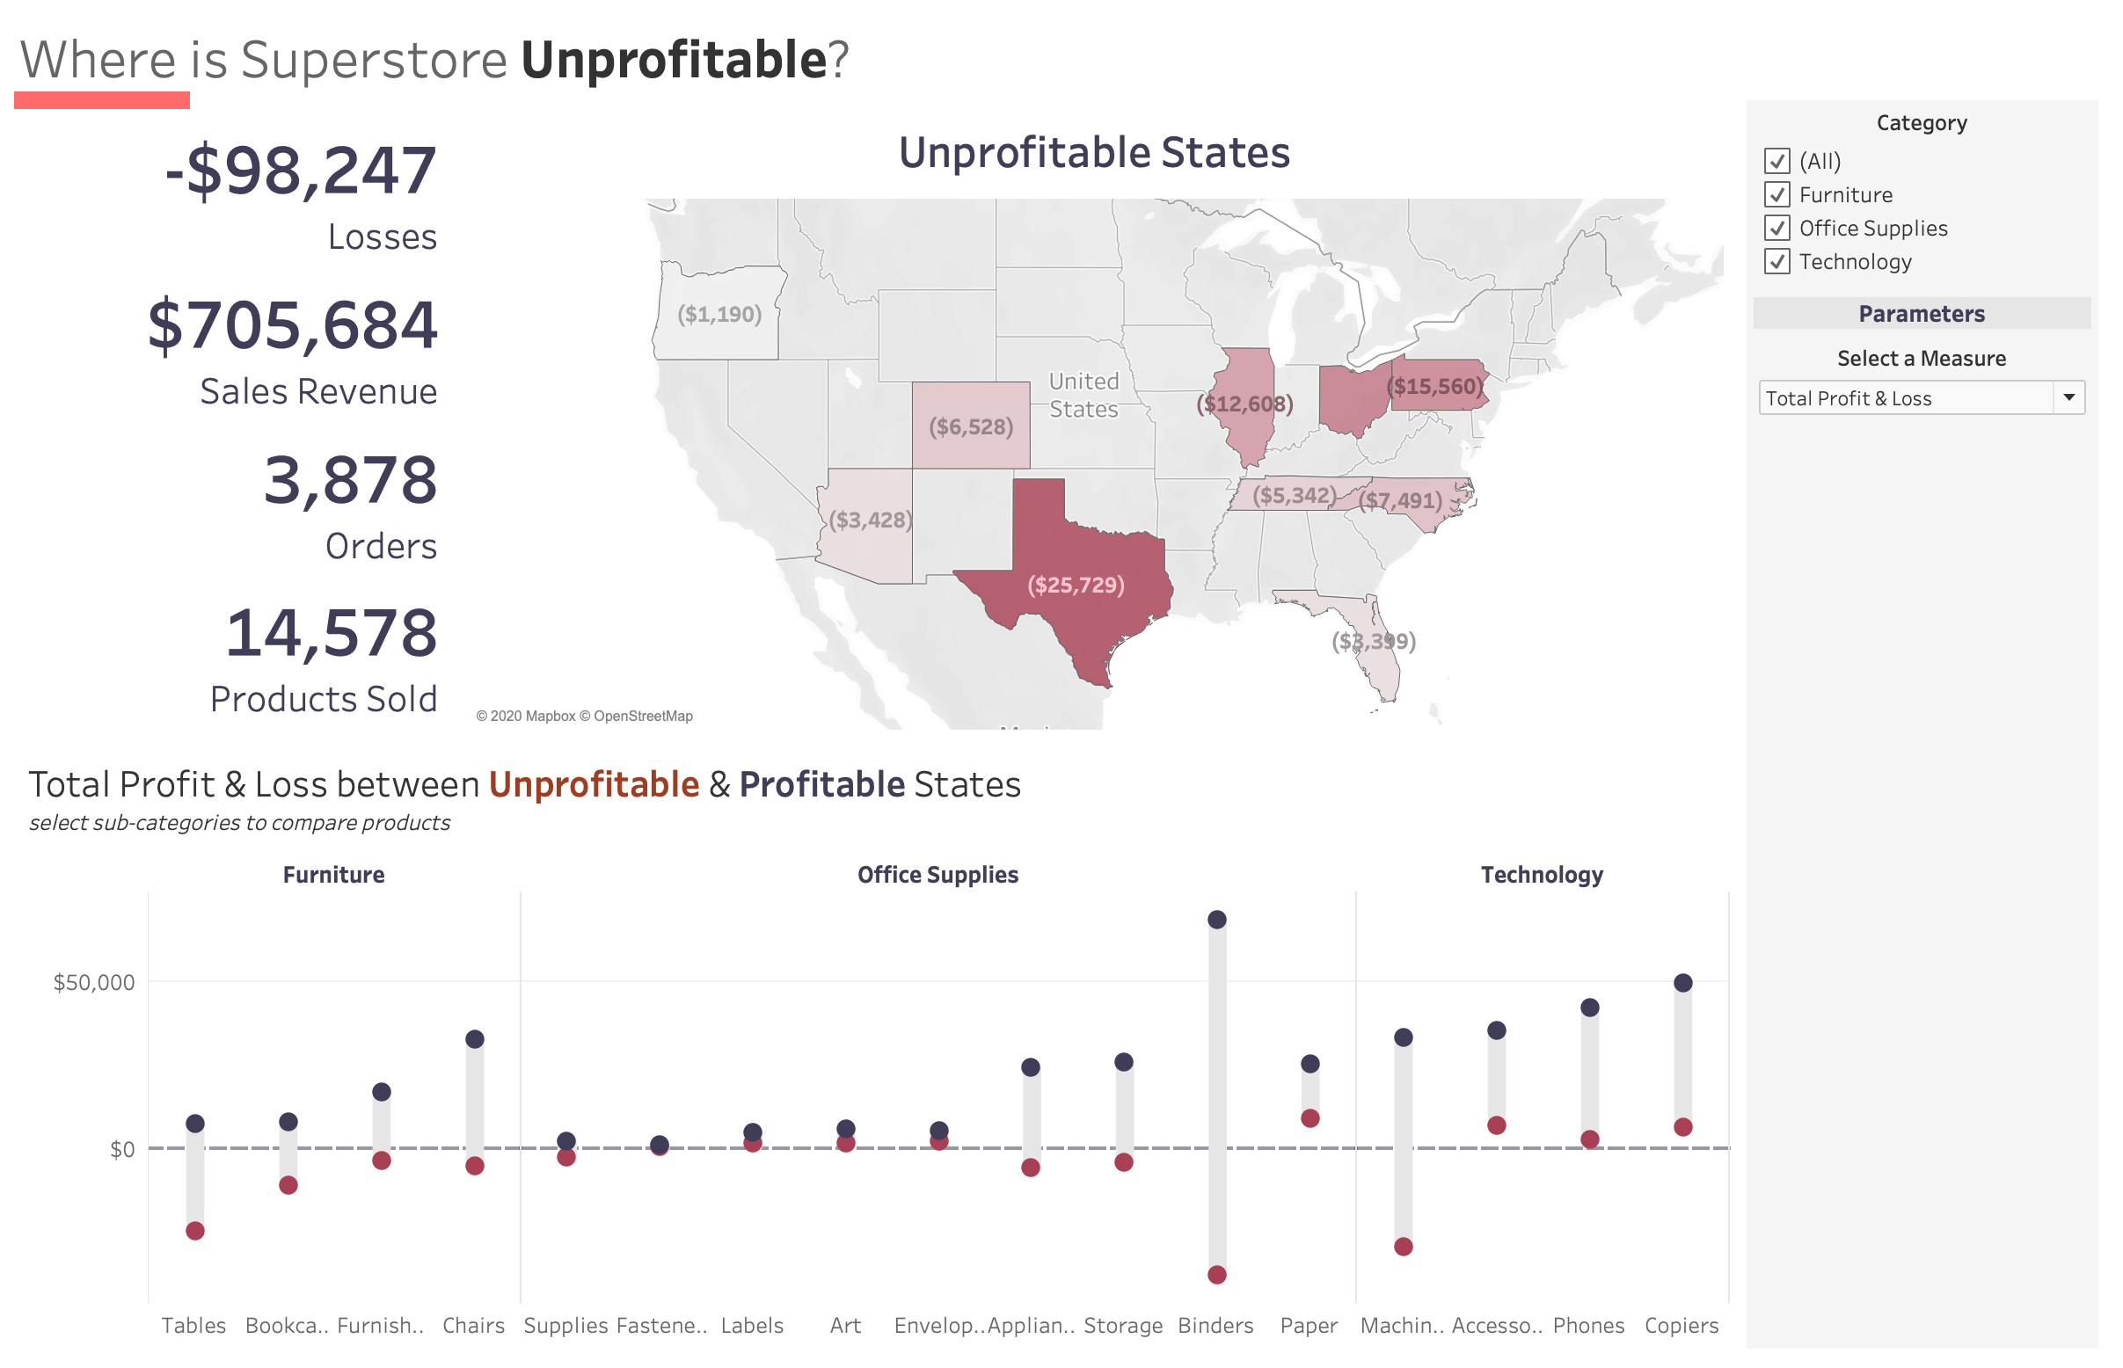

Slide 7
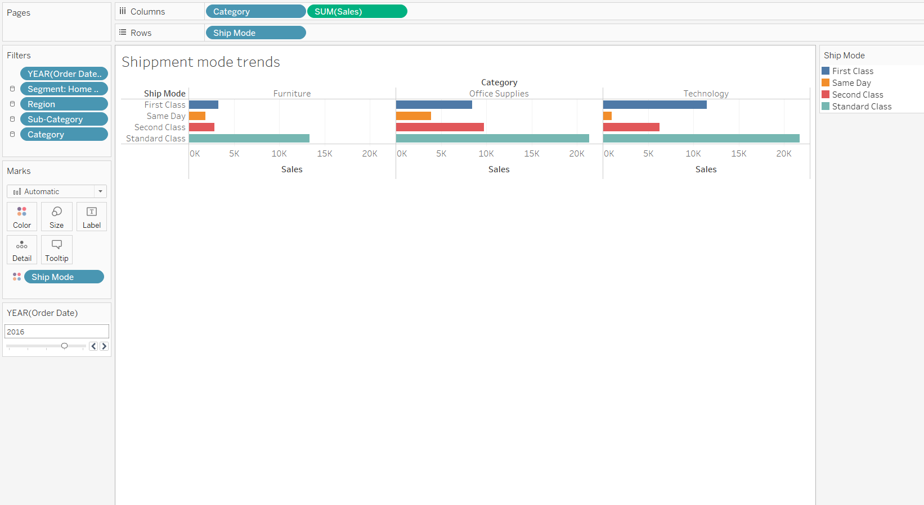
The most common shipping mode preferred is Standard Class as the price for shipping is low and most of the times is takes the same time as second class and sometimes it is also delivered on the same day.

Slide 8
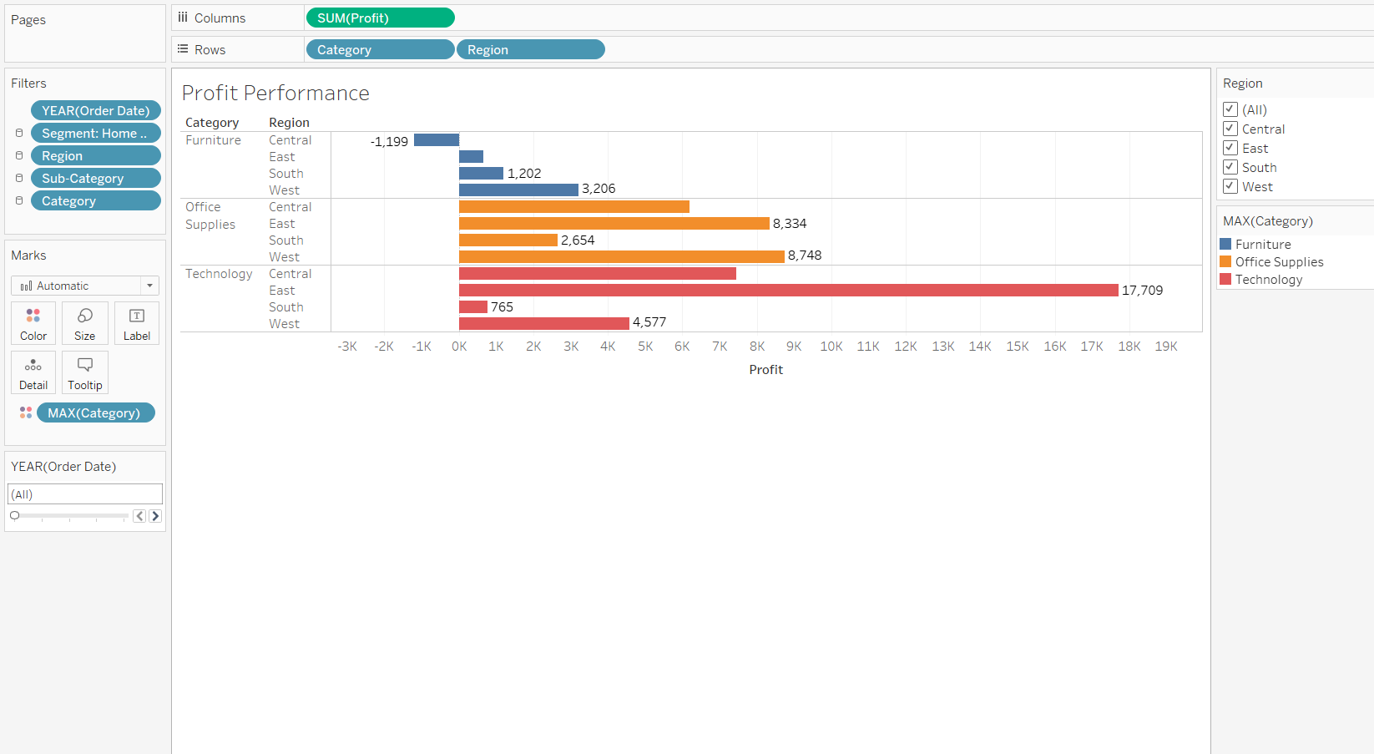
The maximum profit performance is observed in the technology segment towards the east part of the United States. This is because of increase in the number of universities and new emerging industries.

Slide 9
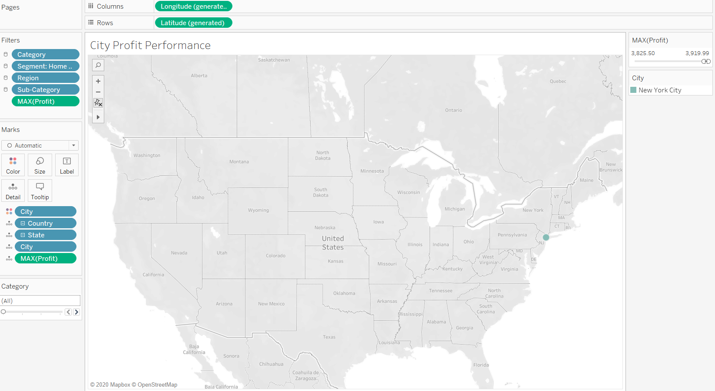
New York State is the highest in sales among all other states. So investing more in this state would increase overall sales.

Slide 10
ARIMA MODEL
ARIMA is a forecasting technique that projects the future values of a series based entirely on its own inertia
Its main application is in the area of short-term forecasting requiring at least 40 historical data points.

Slide 11
SARIMA MODEL
The seasonal ARIMA model incorporates both non-seasonal and seasonal factors in a multiplicative model.
One shorthand notation for the model is ARIMA(p,d,q) x (P,D,Q)S
With p = non-seasonal AR order, d = non-seasonal differencing, q = non-seasonal MA order, P = seasonal AR order, D = seasonal differencing, Q = seasonal MA order, and S = time span of repeating seasonal pattern.

Slide 12
TIME SERIES FORECASTING

Slide 13
Forecast of Furniture Sales from Jan 2018 – Feb 2019

Slide 14
Forecast of Office Supplies Sales from Jan 2018 – Feb 2019

Slide 15
Conclusion
The category Technology from 3 main categories in the supermarket has the highest sales & profit.
The Store should invest more in New York State as it is the highest profit state.
Furniture sales in 2018 -2019 follow the similar trend as the previous year.
Office Supplies Sales in 2018 -2019 show a downward trend but following the same seasonality.
The overall sales is the most Unprofitable in the state of Texas.

